Slide 1



Quantum Financial Forecasting
Alex, Florian, Leonard, Mohamad

Slide 2
What did we achieve?
Visualize the loss values of the models
Early cutting of epochs during training
Calculation of accuracy (from trends and MSE)
Baseline as Linear Regression
Calculation of number of parameters for the models
Quantum Financial Forecasting

Slide 3
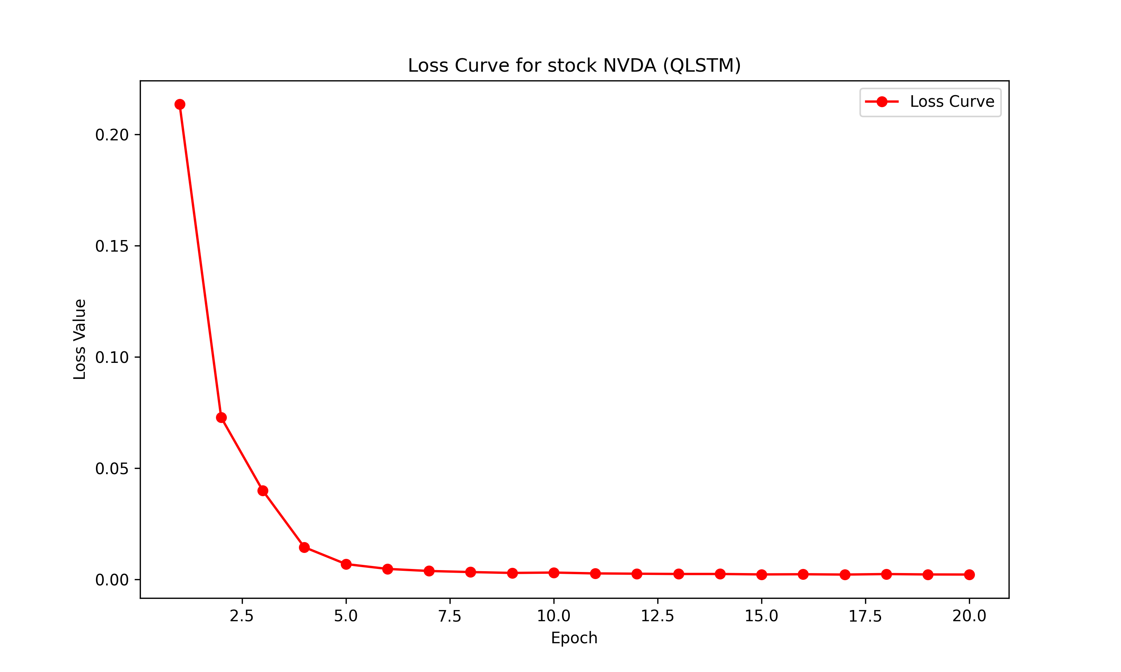
Loss Values
Quantum Financial Forecasting

Slide 4
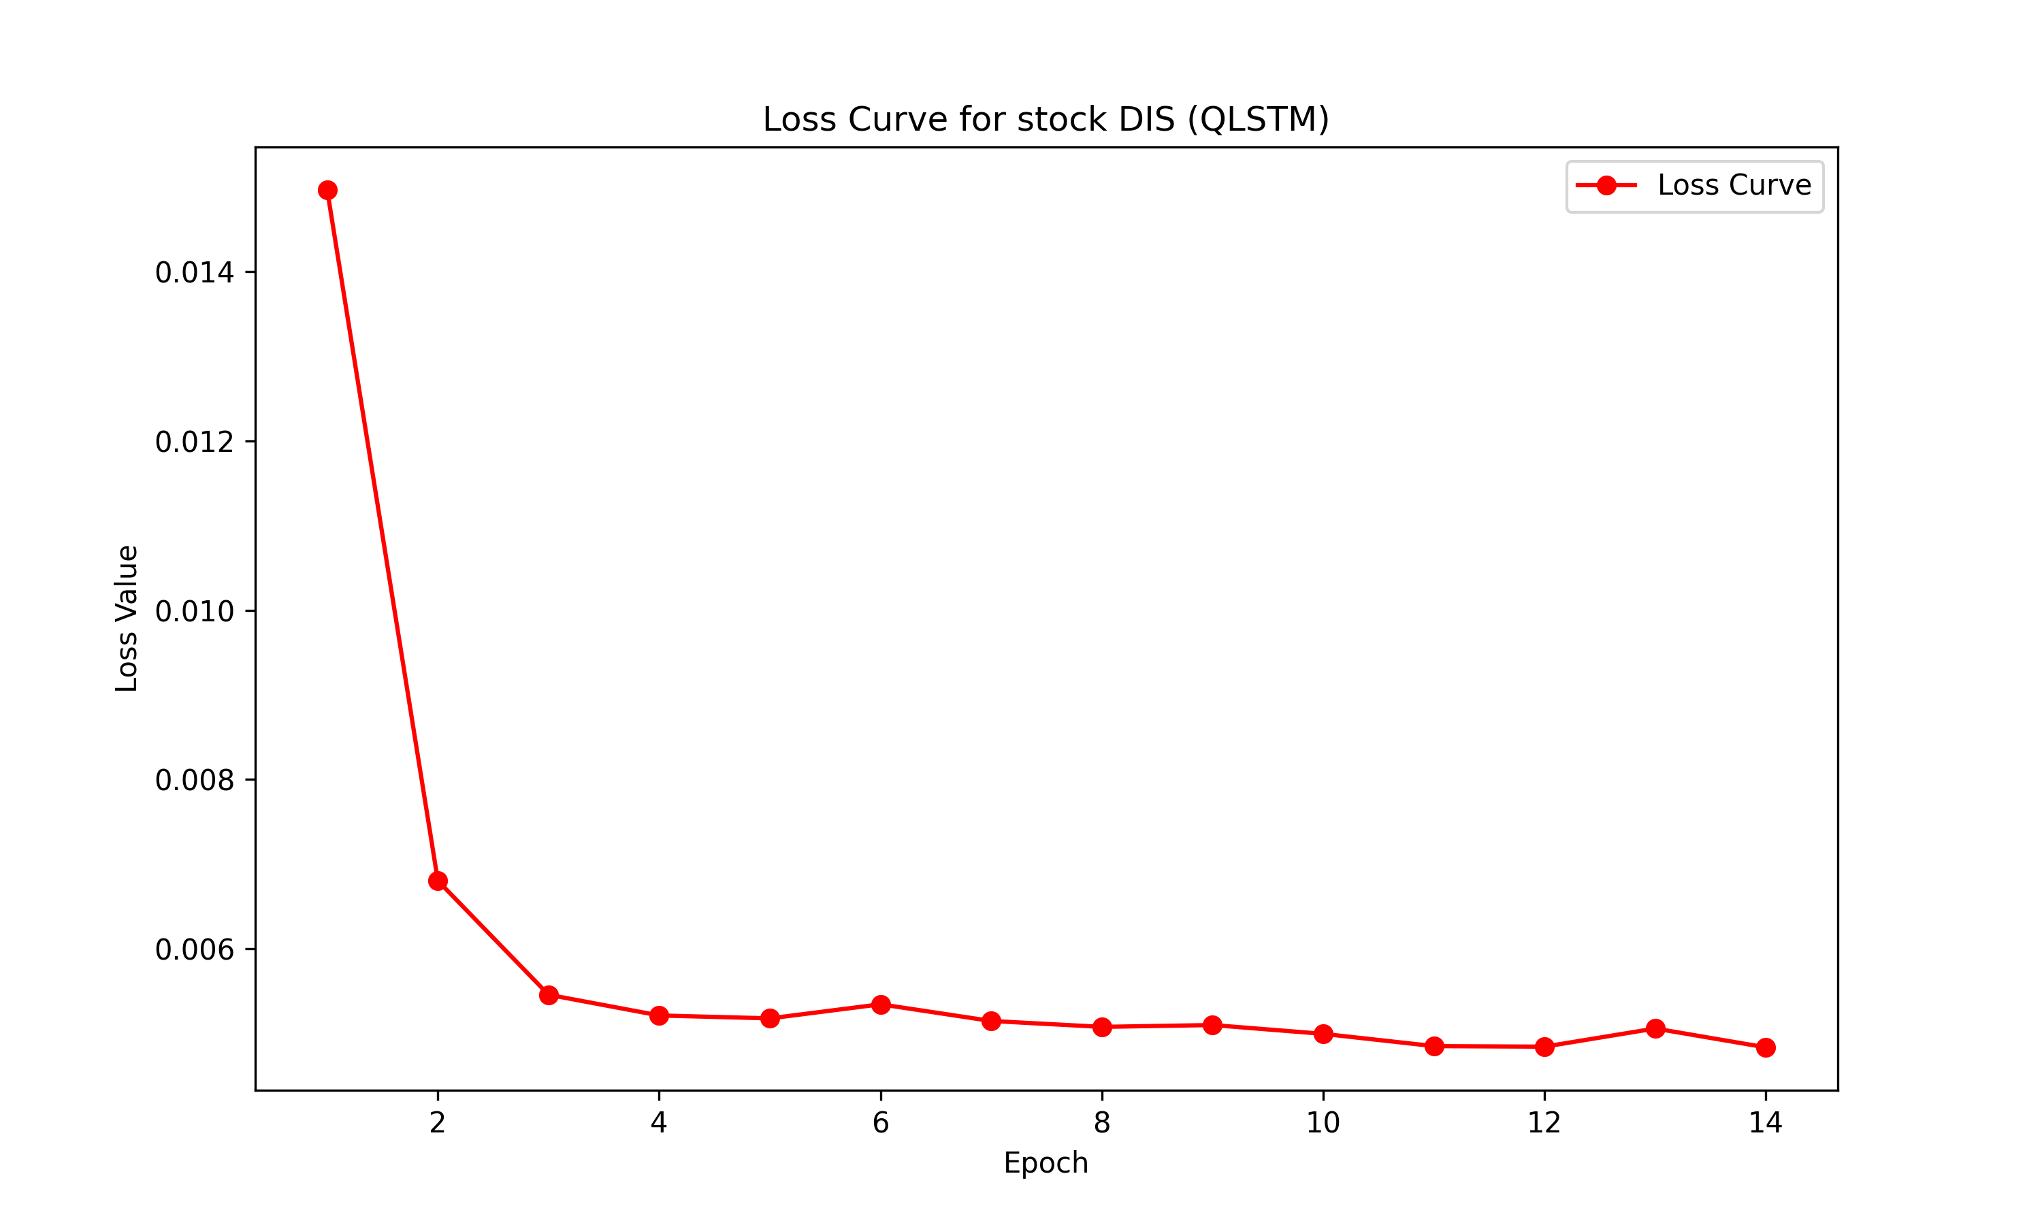
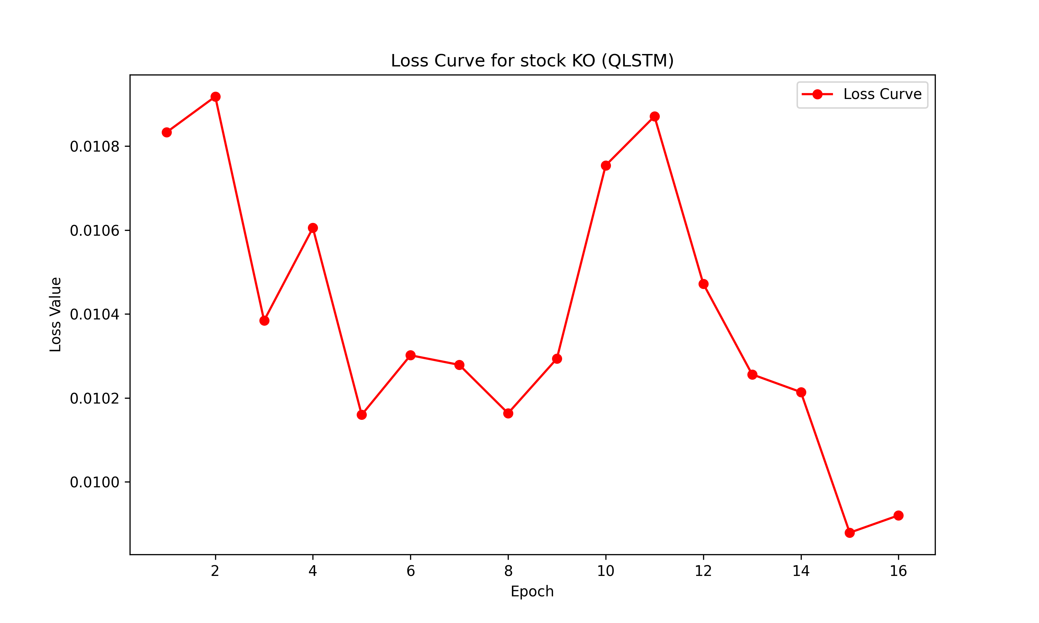
Loss Values – Fine Tuning
Minimal change in the loss values, yet training is needed to find patterns in each stock
Quantum Financial Forecasting

Slide 5
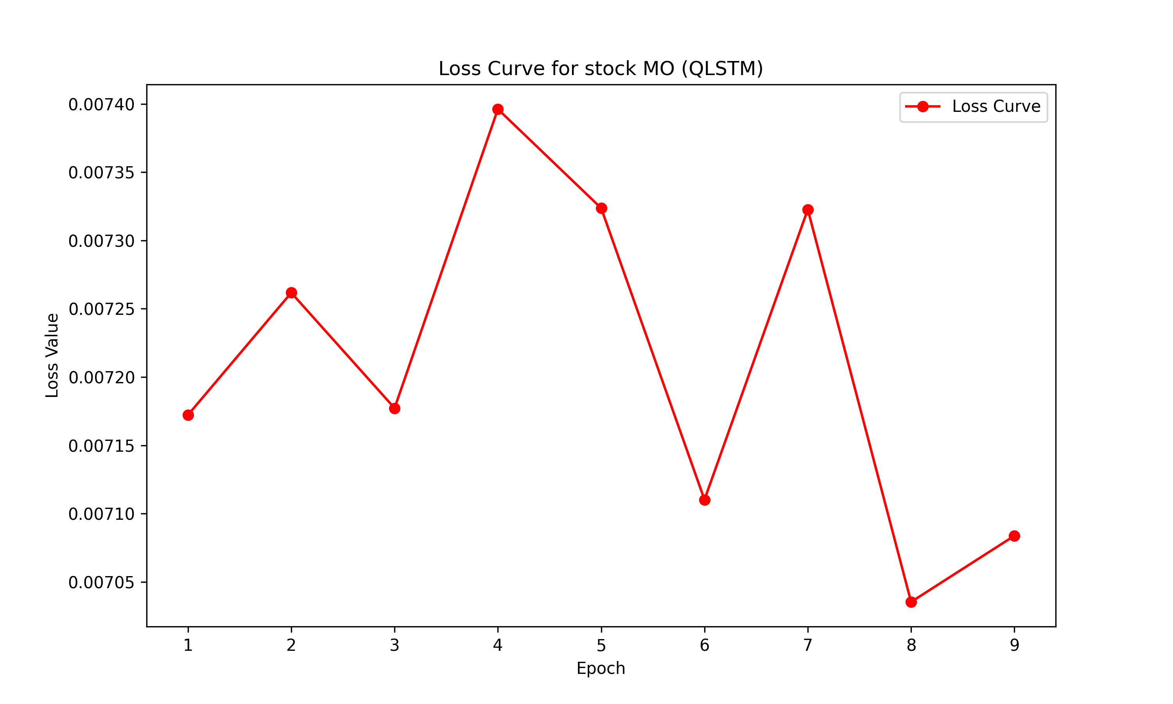
Loss Values – Early Cutting
Quantum Financial Forecasting

Slide 6
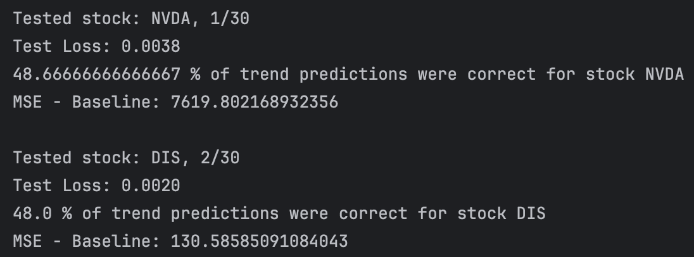
Accuracy
Calculate using trends from the closing price
Calculate using values from MSE during testing
Quantum Financial Forecasting

Slide 7
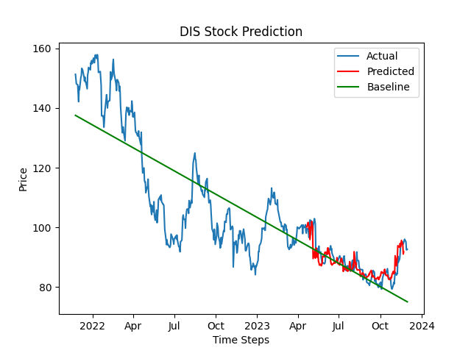
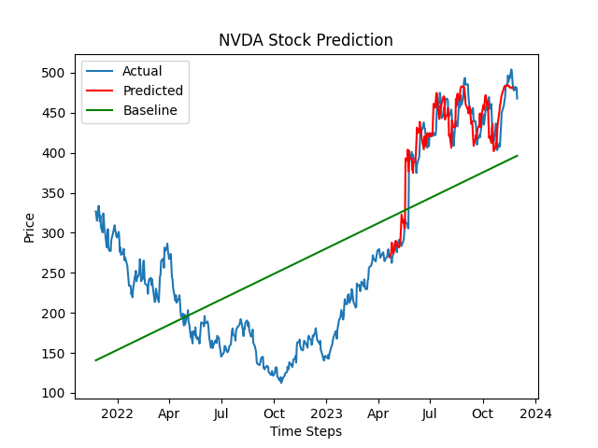
Baseline – Linear Regression
Quantum Financial Forecasting

